Slide 1
Recruiter Program Challenges
The Delta Variant
Mandatory vaccination fears
  COVID testing availability
Staffed for 3,700 mission without defined targets
  Mission of 4,200 Active Duty
  Resource Proposals are in

Slide 2
Recruiter Program Initiatives
People
Officer Recruiting
Detached Duty Recruiters
Additional SELRES recruiters
Process
Waivers
International Leads
Recruiting App (Sales Force)
Funding
National Marketing
Local Marketing
Reserve Marketing
Infrastructure
Mobility
New Offices
Closing Offices

Slide 3
Call to Action
Social Media
  GoCoastGuard on Facebook or Instagram
  Select a post that resonates
  Share with your contacts
Everyone is a Recruiter
  GoCoastGuard.com
  Referral tab
  Put in the individual’s name and contact information
Direct action at one of the Recruiting Offices
  Build a Center of Influence in the community
  No salesmanship needed… you are our best advertisments.

Slide 4
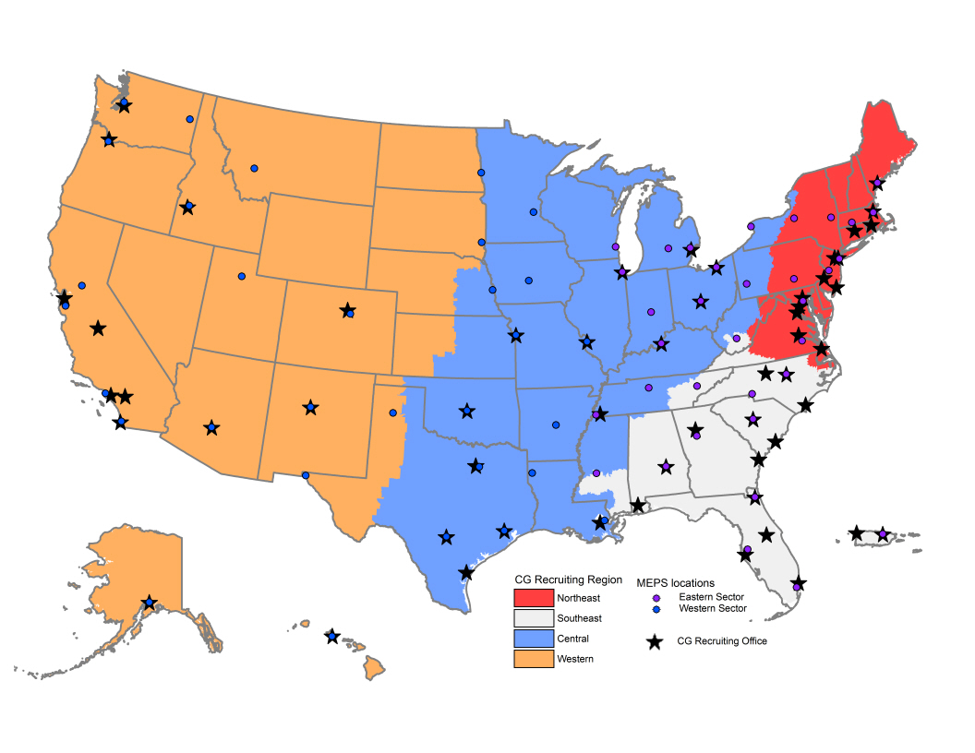
Current Recruiting Office
FY21 Pilot
FY23 Resource Proposal
Notes:
Displayed are the 4 geographic Recruiting Regions (Northeast, Southeast, Central, and Western)
Recruiting Offices (55) do not pair 1:1 with MEPS.
Only 40 of the 65 MEPS are used by a CG Recruiting Office and have a CG Recruiting Service Liaison.
15 CG Recruiting Service Liaisons support more than one primary Recruiting Office.

